Slide 1
Fake News Tracker
Deepti Mishra

Slide 2

Problem
Fake news can easily proliferate, particularly in times of political turbulence and instability. Take a look at the following examples of fake news:
Communications expert Barbara Alvarez warns that "Without the knowledge of appropriately identifying fake news, these websites can do an effective job of tricking the untrained eye into believing it’s a credible source. Indeed, its intention is deception."

Slide 3
Solution
I am using Data science and machine learning tools along with python to build a model for detecting fake news.
Tools used :
JupyterLab(I used VS code IDE)
Python & Libraries
Python Libraries used:
NumPy , Pandas , Sklearn
Model used :Logistic regression model
Other algorithms used: Gradient Tree classifier , Decision Tree classifier, Random Forest classifier

Slide 4
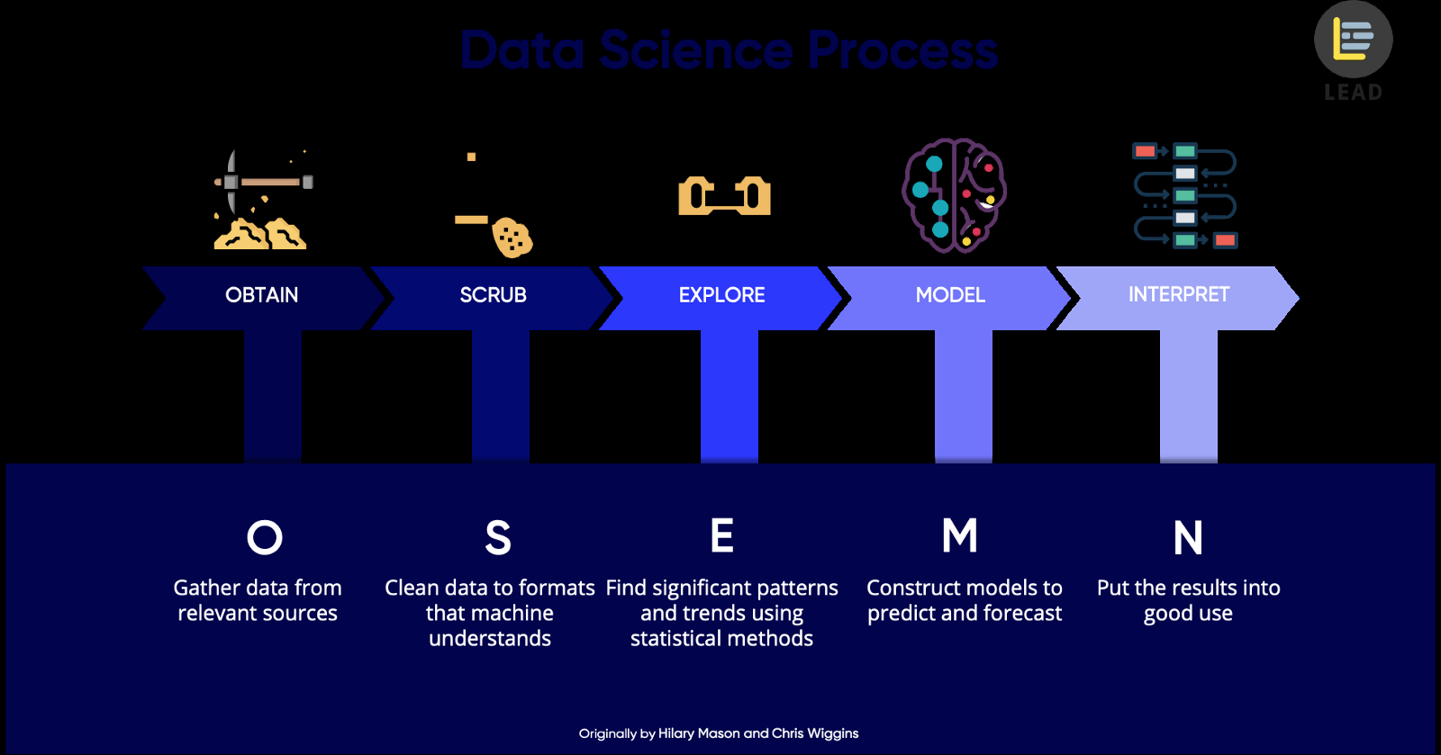

Slide 5
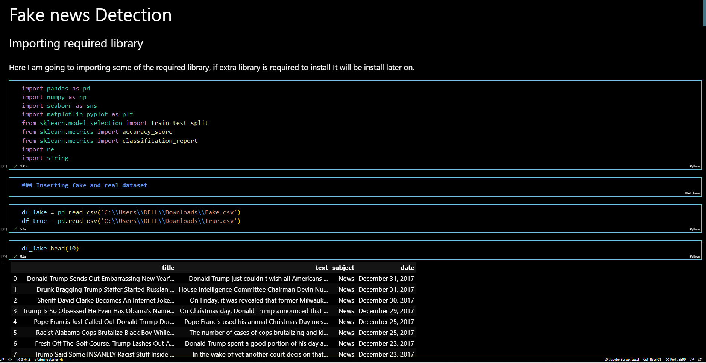

Slide 6
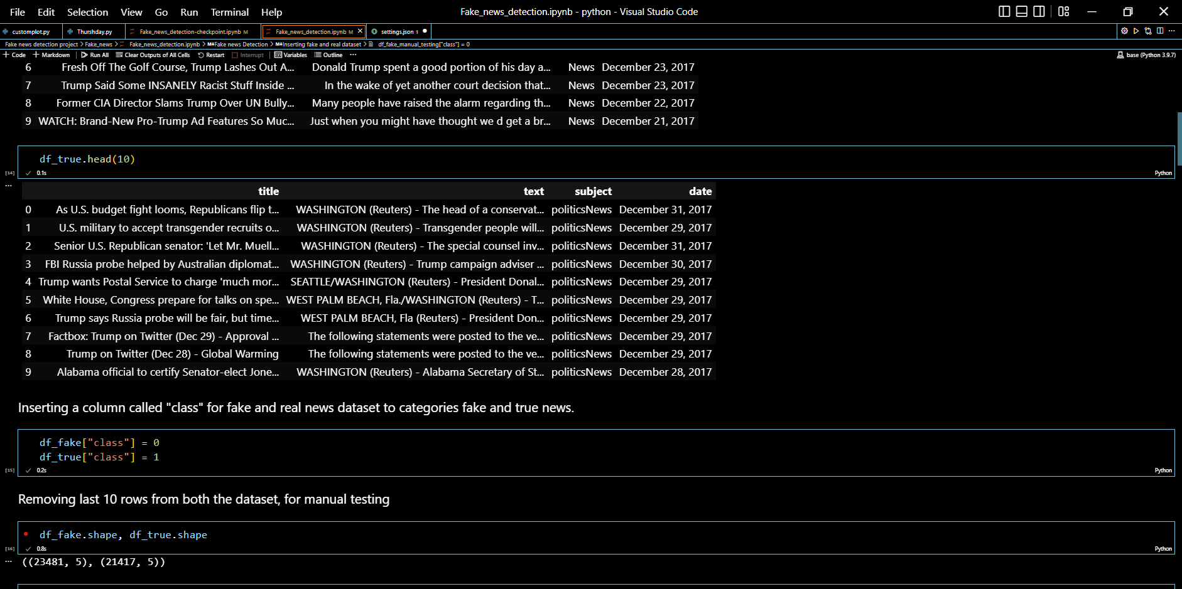

Slide 7
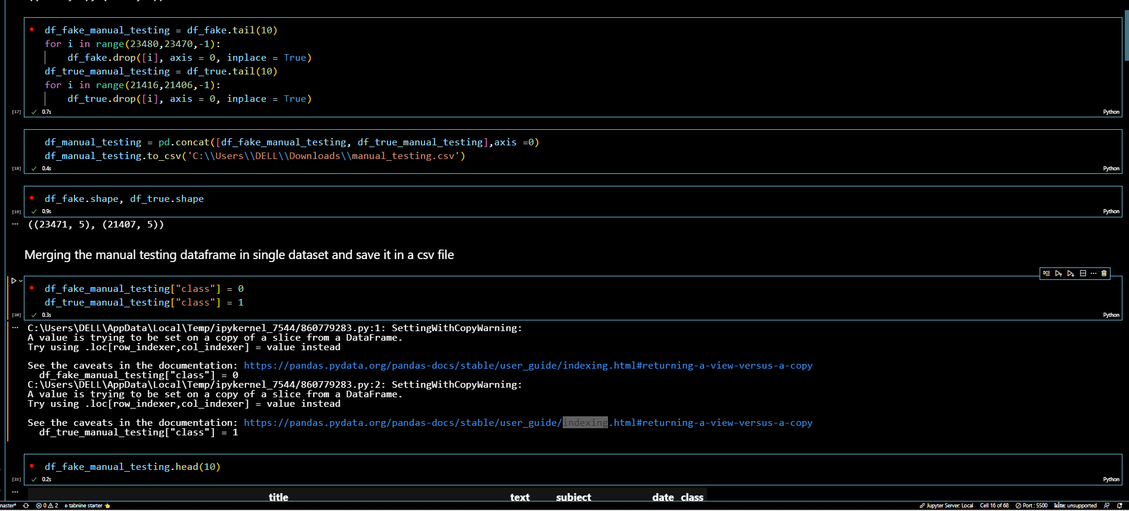

Slide 8
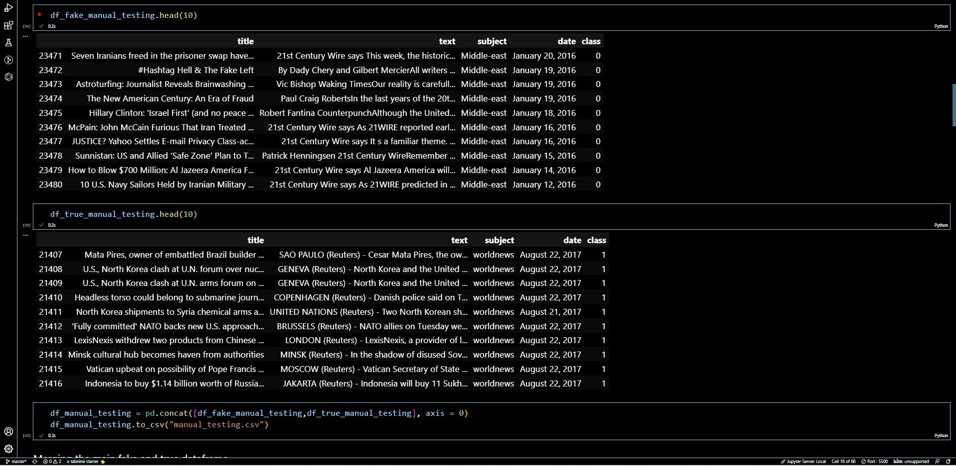

Slide 9
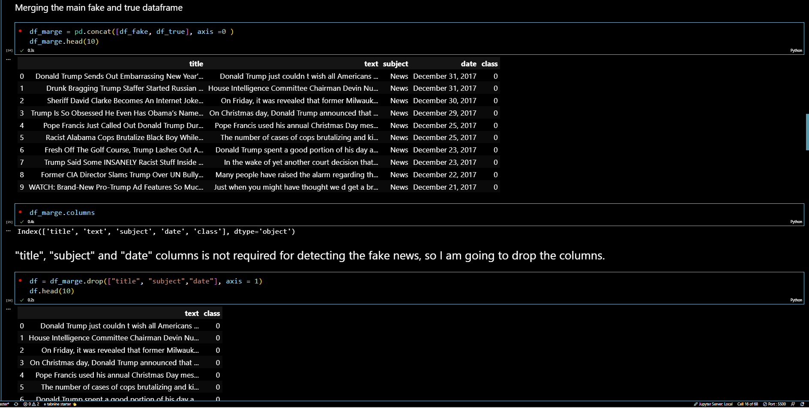

Slide 10
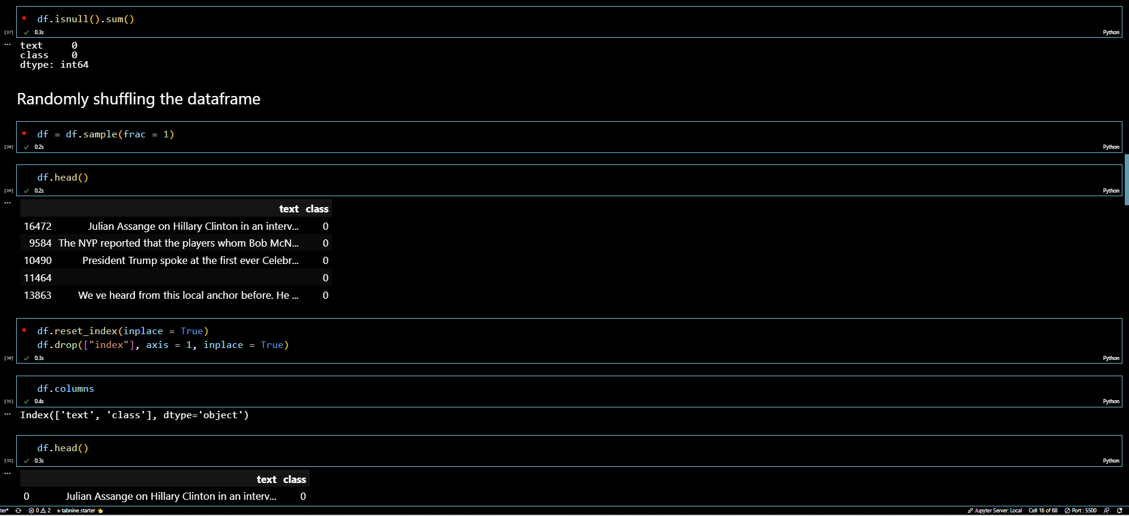

Slide 11
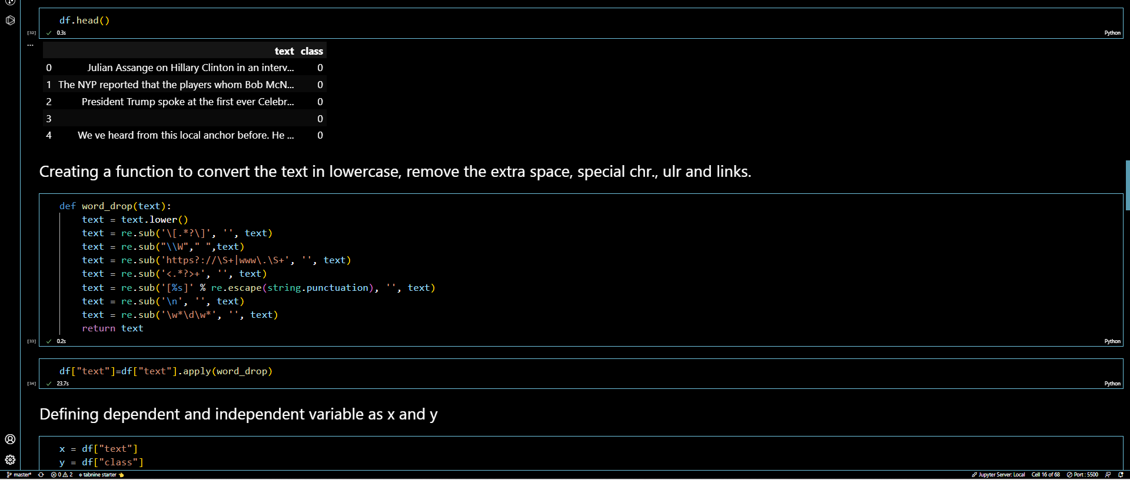

Slide 12
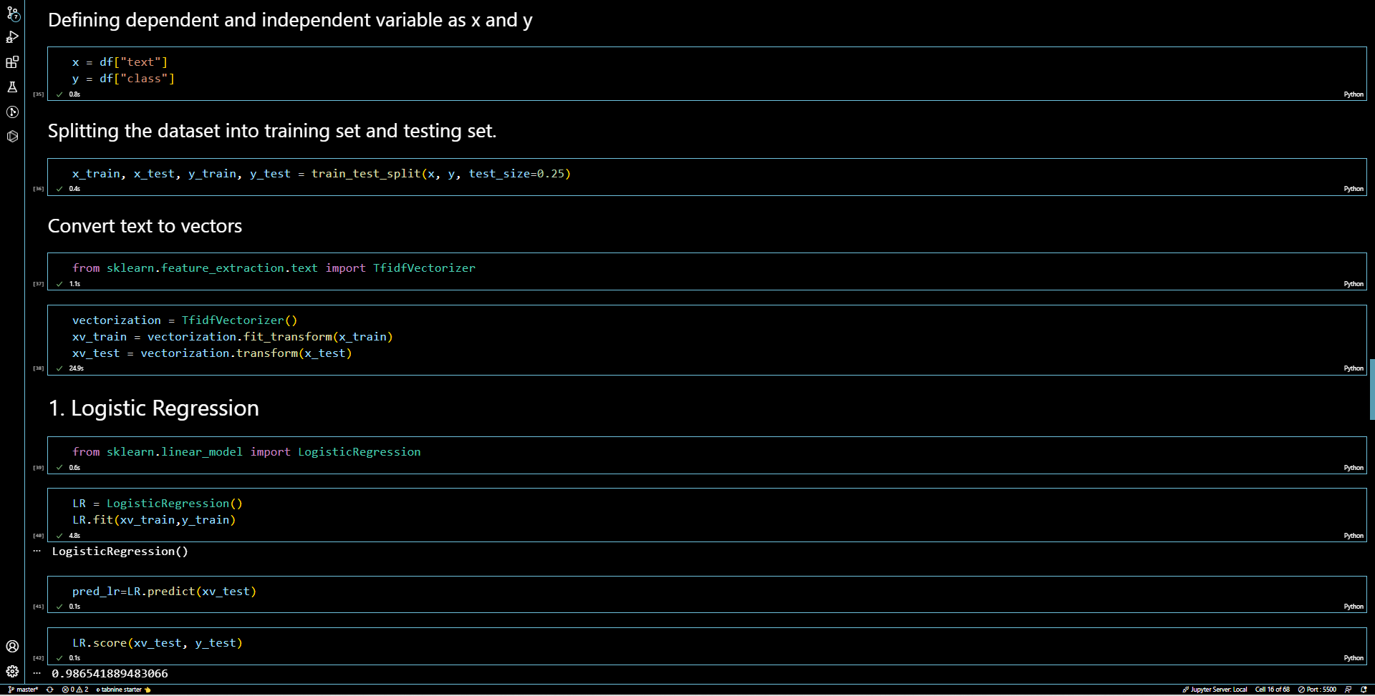

Slide 13
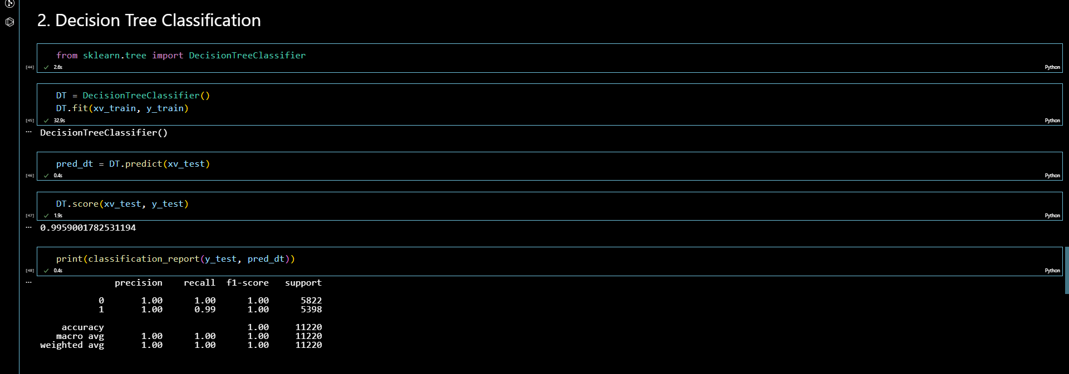

Slide 14
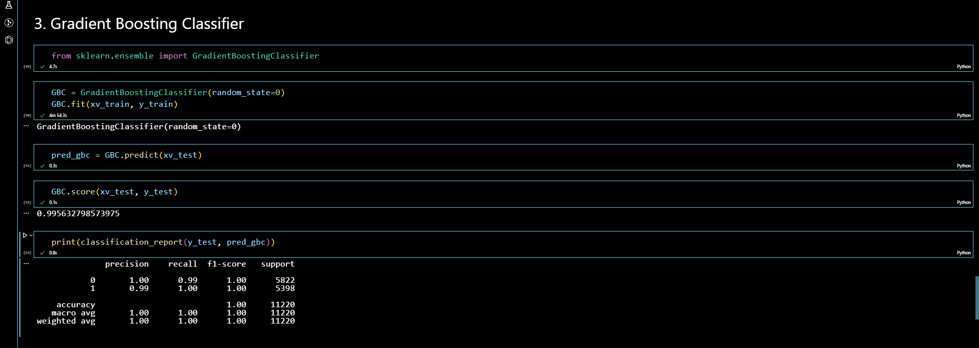

Slide 15
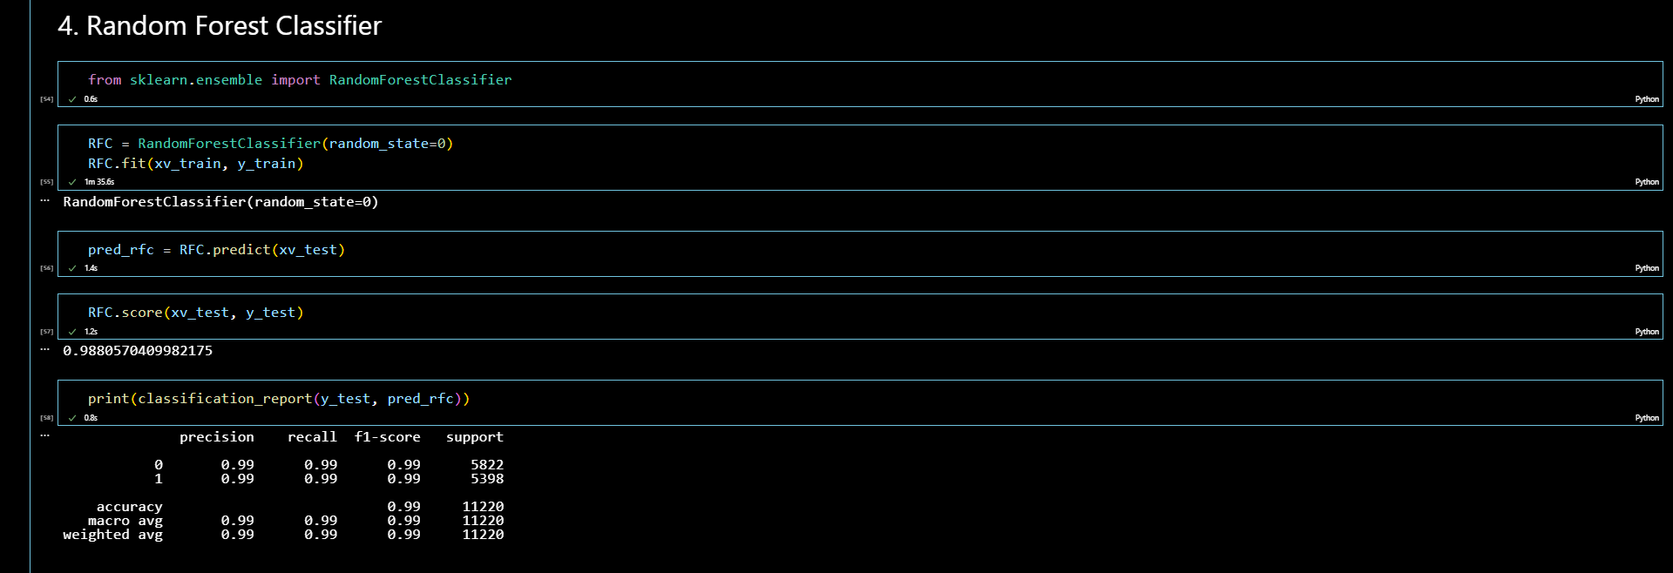

Slide 16
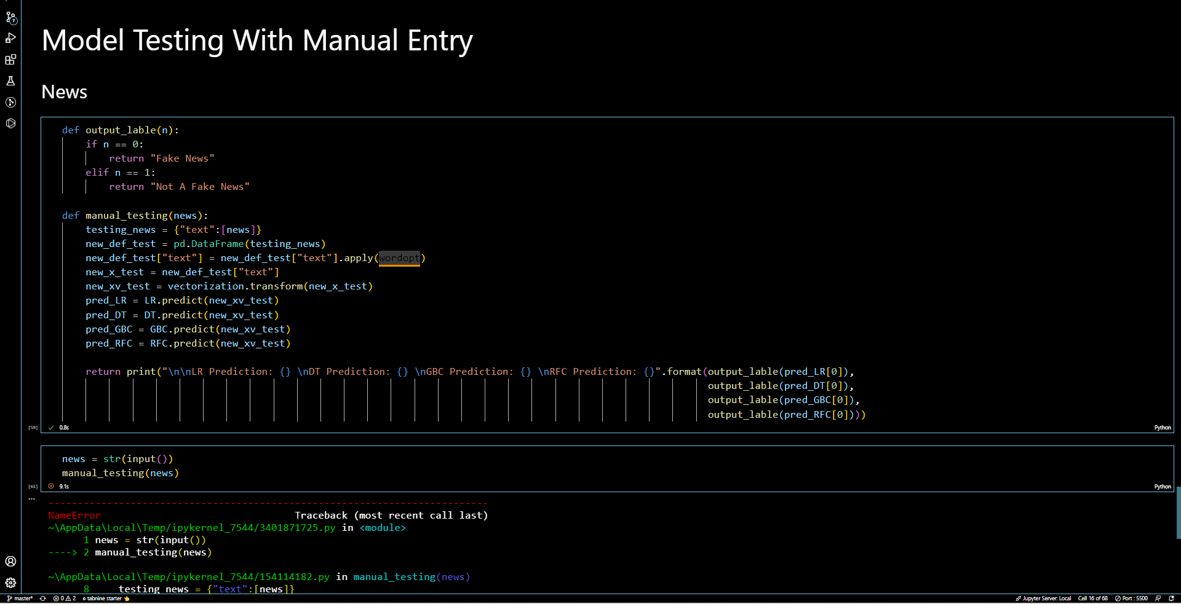

Slide 17
THANKS!

